Slide 1
PREDICTING BUSINESS BANKRUPTCY
A MACHINE LEARNING APPROACH
NAME : Konda Sai kumar
Prashanth Ravindra
Rinu A R
Kondle Sandeep.

Slide 2
INTRODUCTION
Final condition of a company is important for the company, investors, supliers, customers and many others.
Easy to find if a company is in an insolvency proceeding,but not if it will enter insolvency in the future.
Goal of this Work: Predict with a machine Learning model the probability of a company getting into Bankruptcy Or Not and find how accurate this model can be. -> Classification Problem.

Slide 3
OBJECTIVE
This is a classification project, since the variable to predict is binary (bankruptcy or non-bankruptcy). The goal here is to model the probability that a business goes bankrupt from different features.
The data file contains 7 features about 250 companies
The data set includes the following variables:
industrial_risk : 0=low risk, 0.5=medium risk, 1=high risk.
management_risk : 0=low risk, 0.5=medium risk, 1=high risk.
financial flexibility: 0=low flexibility, 0.5=medium flexibility, 1=high flexibility.
credibility: 0=low credibility, 0.5=medium credibility, 1=high credibility.
competitiveness: 0=low competitiveness, 0.5=medium competitiveness, 1=high competitiveness.
operating_risk : 0=low risk, 0.5=medium risk, 1=high risk.
class: bankruptcy, non-bankruptcy (target variable).

Slide 4
DATASET OVERVIEW
TARGET VARIABLE
industrial_risk | management_risk | financial_flexibility | credibility | competitiveness | operating_risk | class
0.5 | 1 | 0 | 0 | 0 | 0.5 | bankruptcy
0 | 1 | 0 | 0 | 0 | 1 | bankruptcy
1 | 0 | 0 | 0 | 0 | 1 | bankruptcy
0.5 | 0 | 0 | 0.5 | 0 | 1 | bankruptcy
1 | 1 | 0 | 0 | 0 | 1 | bankruptcy
1 | 1 | 0 | 0.5 | 0 | 0.5 | bankruptcy
1 | 1 | 0 | 0 | 0 | 0 | bankruptcy
1 | 1 | 0 | 0 | 0 | 0.5 | bankruptcy
1 | 1 | 0 | 0.5 | 0 | 0 | bankruptcy
1 | 1 | 0 | 0.5 | 0 | 1 | bankruptcy

Slide 5
EXPLORATARY DATA ANALYSIS
[85]
0s
data.describe()
output
0s
data.describe()
industrial_risk | management_risk | financial_flexibility | credibility | competitiveness | operating_risk | class | is_outlier
count | 250.000000 | 250.00000 | 250.000000 | 250.000000 | 250.000000 | 250.00000 | 250.000000 | 250.000000
mean | 1.036000 | 1.22800 | 0.752000 | 0.940000 | 0.952000 | 1.14000 | 0.572000 | 0.960000
std | 0.823051 | 0.82141 | 0.803166 | 0.831363 | 0.881364 | 0.86915 | 0.495781 | 0.280562
min | 0.000000 | 0.00000 | 0.000000 | 0.000000 | 0.000000 | 0.00000 | 0.000000 | -1.000000
25% | 0.000000 | 1.00000 | 0.000000 | 0.000000 | 0.000000 | 0.00000 | 0.000000 | 1.000000
50% | 1.000000 | 1.00000 | 1.000000 | 1.000000 | 1.000000 | 1.00000 | 1.000000 | 1.000000
75% | 2.000000 | 2.00000 | 1.000000 | 2.000000 | 2.000000 | 2.00000 | 1.000000 | 1.000000
max | 2.000000 | 2.00000 | 2.000000 | 2.000000 | 2.000000 | 2.00000 | 1.000000 | 1.000000
This statistics such as count, mean, standard deviation, minimum, 25th percentile, median (50th percentile), 75th percentile, and maximum for each numerical column in your dataset.

Slide 6
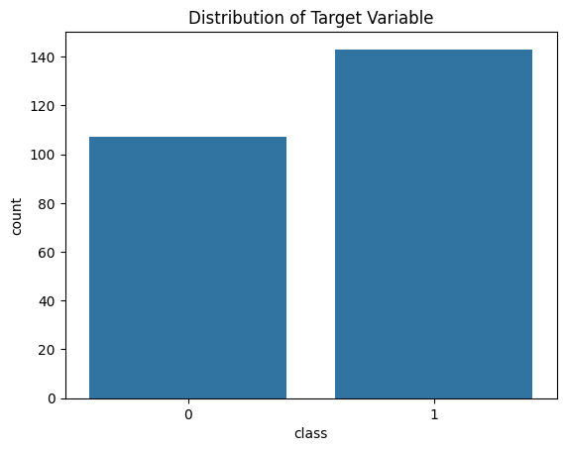
DISTRIBUTION OF TARGET VARIABLE
To visualize the distribution of each feature by class, you can use count plots for categorical features and histograms for numerical features.

Slide 7
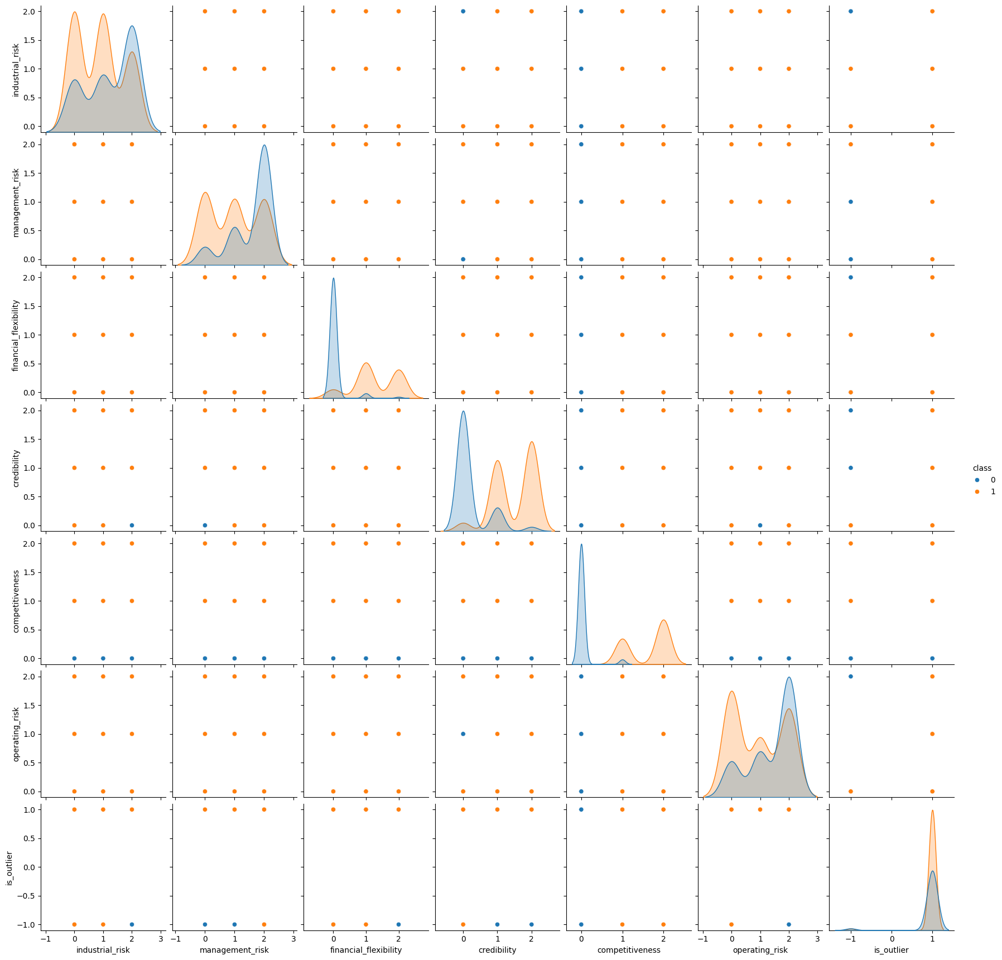
VISUALISE RELATION B/W FEATURES
This will create a grid of scatterplots for each pair of features, with points colored by the 'class' variable. This can help you visualize how the features are related and whether there are any distinct patterns for the two classes.
Top of Form

Slide 8
MODELS USED
LOGISTIC REGRESSION
SUPPORT VECTOR MACHINE
K-NEAREST NEIGHBOUR
NAVIE BAYES MODEL
DECISSION TREE

Slide 9
MODEL PERFORMANCE
MODEL | ACCURACY | TRAINING ACCURACY | TEST ACCURACY
LOGISTIC REGRESSION | 1.0 | - | -
SUPPORT VECTOR MACHINE | 0.95 | - | -
K-NEAREST NEIGHBOUR | 1.0 | - | -
NAVIE BAYES MODEL | 1.0 | 1.0 | 1.0
DECISION TREE | 0.93 | - | -

Slide 10
CONFUSION MATRIX AND CLASSIFICATION REPORT
DECISION TREE
CONFUSION MATRIX:
[[21 0 ]
[ 2 26]]
CLASSIFICATION REPORT | PRECISION | RECALL | F1-SCORE | SUPPORT
0 | 0.91 | 1.00 | 0.95 | 21
1 | 1.00 | 0.93 | 0.98 | 28
ACCURACY | - | - | 0.96 | 49
MACRO AVG | 0.96 | 0.96 | 0.96 | 49
WEG AVG | 0.96 | 0.96 | 0.96 | 49
LOGISTIC REGRESSION :
CONFUSION MATRIX
[[ 21 ,0 ]
[ 0, 28 ]]

Slide 11
INSIGHTS & CONCLUSION
Based on the analysis conducted on the dataset, the following findings and insights can be summarized:
Class Distribution: The dataset contains two classes: bankruptcy and non-bankruptcy. The distribution of classes shows an imbalance, with more instances of non-bankruptcy compared to bankruptcy.
Feature Analysis:
Industrial Risk: There is a higher proportion of companies with medium to high industrial risk in the bankruptcy class.
(Industrial risk typically refers to the likelihood or potential for a business to face difficulties or losses due to factors related to its industry or sector. It is often assessed based on various factors such as market conditions, regulatory environment, technological changes, competition, and other industry-specific risks.)

Slide 12
Management Risk: Companies with high management risk are more likely to be in the bankruptcy class.
Financial Flexibility: Bankrupt companies tend to have lower financial flexibility.
Credibility: Bankrupt companies generally have lower credibility.
Competitiveness: There is a noticeable difference in competitiveness between the two classes, with bankrupt companies showing lower competitiveness.
Operating Risk: Bankrupt companies exhibit higher operating risk compared to non-bankrupt companies.
Pair plot Analysis: The pair plot shows varying degrees of separation between the classes for different pairs of features. Features like financial flexibility, credibility, and industrial risk show distinct patterns between the two classes.

Slide 13
FUTURE STEPS
Fine-tune machine learning models to improve performance.
Address class imbalance through oversampling, undersampling, or class weights.
Explore other algorithms such as SVM, XGBoost, or neural networks.
Conduct feature engineering to create new features or reduce dimensionality.
Use additional evaluation metrics and cross-validation for robust model assessment.
Deploy and monitor the model in a production environment, updating it as needed.
Overall, the analysis provides valuable insights into the dataset and sets the stage for building predictive models to identify companies at risk of bankruptcy.

Slide 14
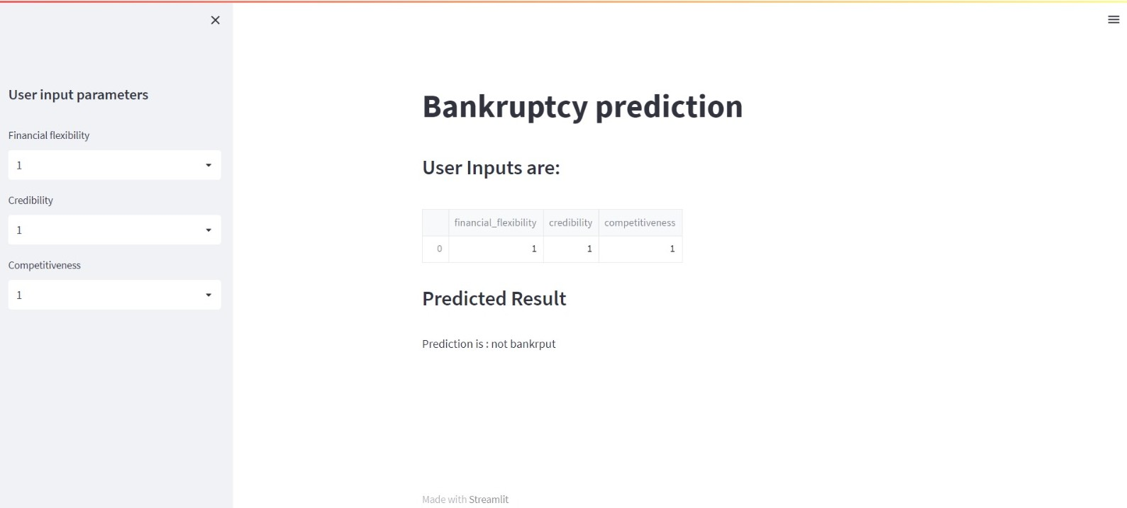
DEPLOYMENT USING STREAMLIT

